Slide 1
Pipelining
Pipelining is a technique of decomposing a sequential process into sub-operations, with each sub-process being executed in a special dedicated segment that operates concurrently with all other segments.
A pipeline can be visualized as a collection of processing segments through which binary information flows.
Each segment performs partial processing dictated by the way the task is partitioned.
The result obtained from the computation in each segment is transferred to the next segment in the pipeline.
The final result is obtained after the data have passed through all segments.
It is characteristic of pipelines that several computations can be in progress in distinct segments at the same time.

Slide 2
Example: Suppose that we want to perform the combined multiply and add operations with a stream of numbers.
Ai × Bi + Ci for i = 1, 2, 3, . . . , 7
So the sub-operation performed in each segment of pipeline are as follow
R1<- Ai, R2<-Bi // Input Ai and Bi
R3<- R1*R2, R4<-Ci // Multiply and input Ci
R5<- R3+R4 // Add Ci to product

Slide 3
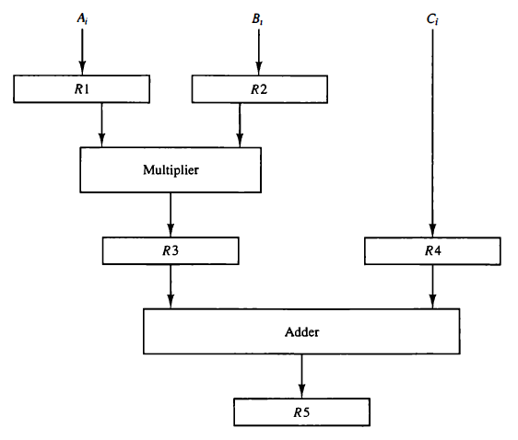
R1 through R5 are registers that receive new data with every clock pulse. The multiplier and adder are combinational circuits. The five registers are loaded with new data every clock pulse.

Slide 4
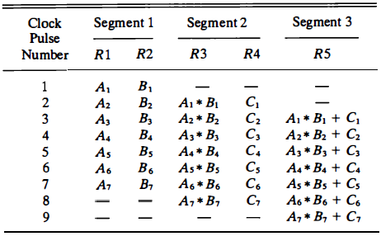
The first clock pulse transfers A1 and B1 into R1 and R2.
The second clock pulse transfers the product of R1 and R2 into R3 and C1 into R4. The same clock pulse transfers A2 and B2 into R 1 and R2.
The third clock pulse operates on all three segments simultaneously.
It places A, and B, into R1 and R2, transfers the product of R1 and R2 into R3, transfers C, into R4, and places the sum of R3 and R4 into R5. It takes three clock pulses to fill up the pipe and retrieve the first output from R5.
Content of Registers in Pipeline Example

Slide 5
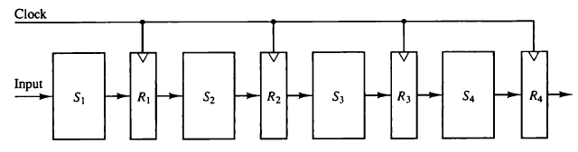
General Considerations
The simplest way of viewing the pipeline structure is to imagine that each segment consists of an input register followed by a combinational circuit.
The register holds the data and the combinational circuit performs the sub-operation in the particular segment.
The output of the combinational circuit in a given segment is applied to the input register of the next segment.
A clock is applied to all registers after enough time has elapsed to perform all segment activity. In this way the information flows through the pipeline one step at a time. Four segment pipeline is shown below

Slide 6
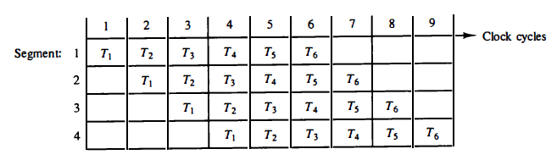
The operands pass through all four segments in a fixed sequence. Each segment consists of a combinational circuit Si, that performs a sub-operation over the data stream flowing through the pipe.
The segments are separated by registers Ri, that hold the intermediate results between the stages.
Information flows between adjacent stages under the control of a common clock applied to all the registers simultaneously.
We define a task as the total operation performed going through all the segments in the pipeline.
The behavior of a pipeline can be illustrated with a space-time diagram. The following diagram that shows the segment utilization as a function of time.
The horizontal axis displays the time in clock cycles and the vertical axis gives the segment number.
Space time diagram for pipeline

Slide 7
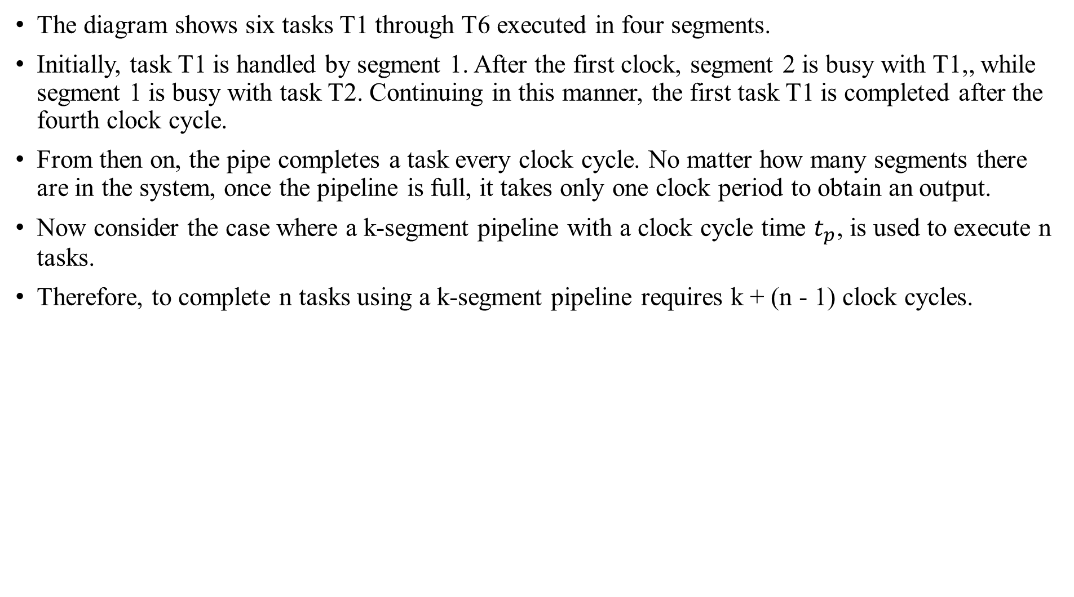
The diagram shows six tasks T1 through T6 executed in four segments.
Initially, task T1 is handled by segment 1. After the first clock, segment 2 is busy with T1,, while segment 1 is busy with task T2. Continuing in this manner, the first task T1 is completed after the fourth clock cycle.
From then on, the pipe completes a task every clock cycle. No matter how many segments there are in the system, once the pipeline is full, it takes only one clock period to obtain an output.
Now consider the case where a k-segment pipeline with a clock cycle time $t_{p}$, is used to execute n tasks.
Therefore, to complete n tasks using a k-segment pipeline requires k + (n - 1) clock cycles.

